Slide 1
CT026-3-2
Human Computer Interaction
Human Computer Interaction
Design Principles
Level 2
Prepared by: RZW First Prepared on: December, 2007 Last Modified on: Feb 2018
Quality checked by: MOH
Copyright 2004 Asia Pacific Institute of Information Technology

Slide 2
Topic & Structure of the lesson
Six Design Principles

Slide 3
Learning Outcomes
At the end of this lecture, you should be able to :
  - Identify a range of usability design principles and of how they can be applied in design
  Evaluate the existing products or systems based on the design principles

Slide 4
Design Principles
Visibility
Feedback
Constraints
Mapping
Consistency
Affordances
(Nielsen,1998)

Slide 5
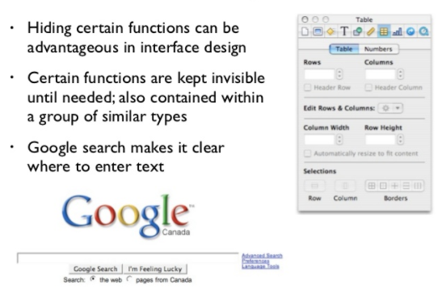
Visibility
Referring to the making the most needed functions inside the application are visible enough for the user to see, to find, to allocate and able to know what to do with it.
In applying this principle you need to put in mind that you can’t make everything visible, because it’ll ultimately clutter the interface but instead need to prioritize what interface elements are by far the most important for the user experience and prioritize their visibility.

Slide 6
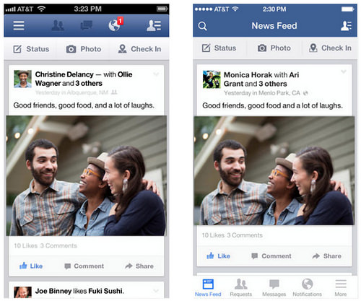
Visibility Cont..
The hamburger menu provides a convenient place to store a variety of menu items in a mobile app, it comes at a huge disadvantage: the lack of visibility of the contained menu items. We've seen a shift in major apps like Facebook away from hamburger menus and back toward tab-bar menus to improve the visibility of their key experiences.

Slide 7
Visibility Cont..
  One of the most important design principles is visibility
Visibility is achieved by placing the controls in a
highly visible location
Designing for visibility means that just by looking, users
can see the possibilities for action
Visibility is often violated in order to make things
"look good"

Slide 8



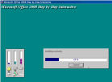

Feedback
Why add push-down effect
when the button is pressed?
Is this useful?
Why does the telephone touchpad provide audible feedback when the keys are pressed?
Why progress bar?

Slide 9
Feedback Cont..
It’s referring about sending back information about what action has been done what has been accomplished, allowing the user to continue with the activity.
Various kind of feedback are available for interaction design such as audio, tactile (touch responses / feedback), verbal, visual and combination of these. The key is to design the experience to never leave the user guessing about what action they have taken and the consequence of doing so.

Slide 10
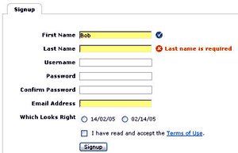
Feedback Cont..
Feedback example - verbal

Slide 11

Feedback Cont..

Slide 12
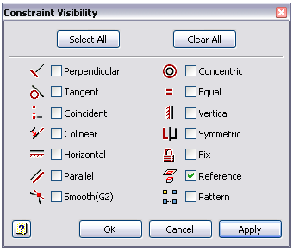
Constraints
It’s referring the way in restricting the kind of user interaction that can take place at a given moment.
There are various way to achieve this. A common design practice in user graphical user interface is to deactivate certain menu options by shading them, thereby restricting the user to only click the one that clickable.
Only able to click the choice given for this activity, cannot do anything apart from that.

Slide 13
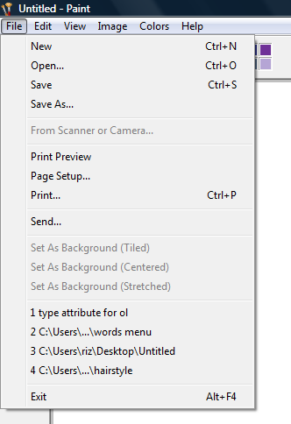
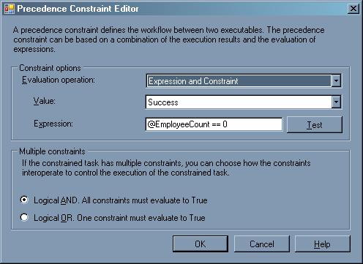
Constraints cont..
Constraint example

Slide 14
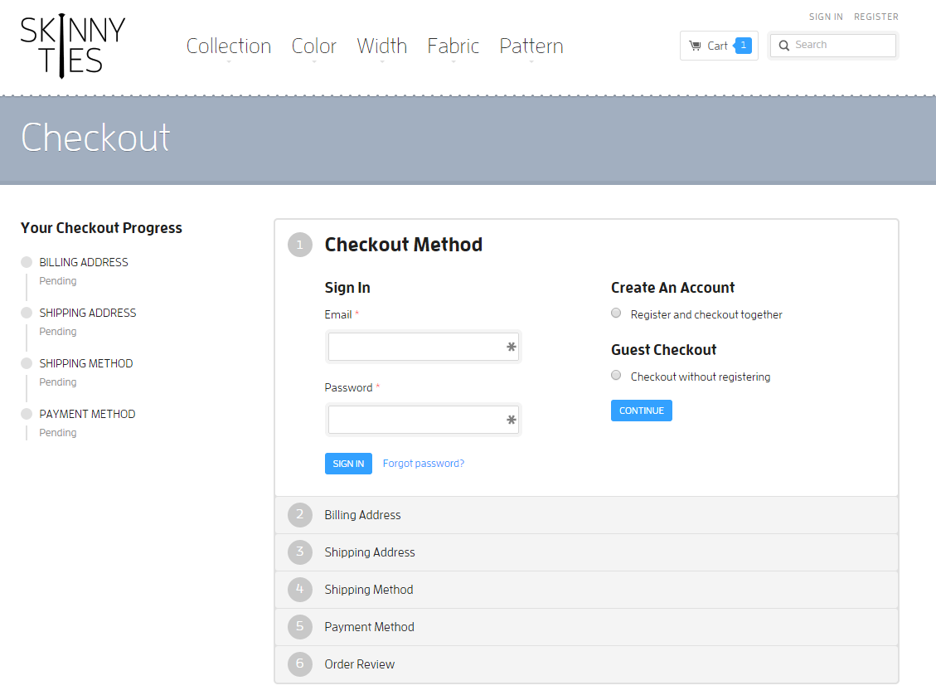
Constraints Cont..
A common formula for e-commerce software demonstrates this idea in the checkout process. On this site, you can see there are six overall steps for the user to complete the order. The system show the users which steps to take and when. By restricting the flow of the interface, users are forced to complete the task in the proper sequence. It is a constraint so natural that I can hardly imagine it any other way.

Slide 15
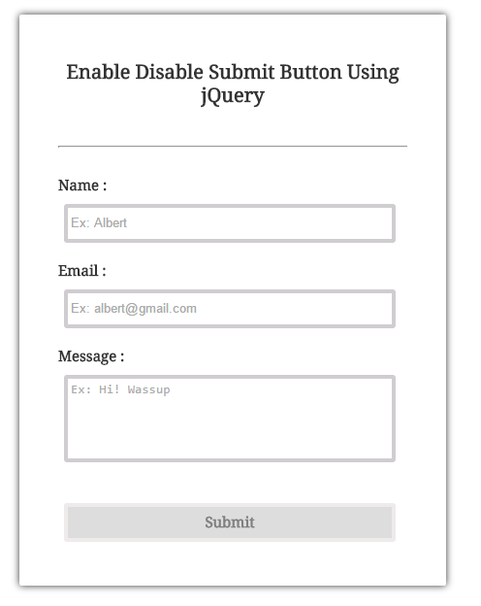
Constraints Cont..
This jQuery tutorial demonstrates how to disabled the submit button on a form until all of the fields are filled in.

Slide 16
Constraints Cont..
Restricting the possible actions that can be performed
Helps prevent user from selecting incorrect options

Slide 17
Mapping
Why is this a poor mapping of control buttons for the sequence of actions of fast rewind, rewind, play and fast forward?
Suggest a better mapping

Slide 18
Mapping Cont..
Why is this a better mapping?

Slide 19

Mapping Cont..
Relationship of the control and their effects
Mapping is about having a clear relationship between controls and the effect they have on the world. You want this mapping to feel as natural as possible.
This refers to the design on controls such that they reflect the way they behave, or the results achieved by using them.
This slider also has a strong mapping, since it's clear moving it to the right will increase it's value versus moving it to the left will decrease it.

Slide 20
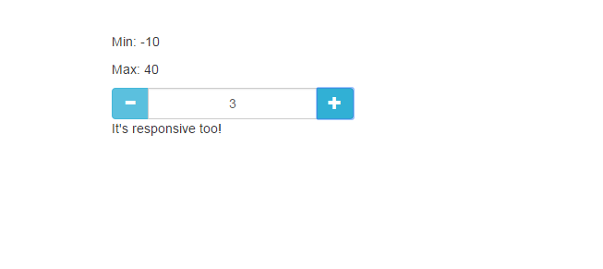
Mapping Cont..
The plus and minus signs are perfectly mapped to their function. The mapping is really strong in that the plus sign is to the right, or up, and the negative is to the left, or down.
Therefore mapping is how accurately you able to map the control to the functions they perform

Slide 21
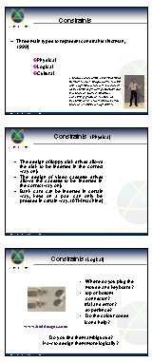
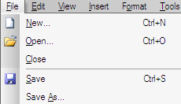
Consistency
Design interfaces to have similar operations and use similar elements for similar tasks
Referring to the one that follow the rules, such as using the same operation to select all objects and others.
For example:
  Use of short cut keys
  always use ctrl key plus first initial of the command for an operation
  – ctrl+C, ctrl+S, ctrl+O
Main benefit is consistent interfaces are easier to learn and use

Slide 22
Consistency
When consistency breaks down?
What happens if there is more than one command starting with the same letter?
    - e.g. save, spelling, select, style
Have to find other initials or combinations of keys, thereby breaking the consistency rule
    - e.g. ctrl+S, ctrl+shift+L
Increases learning burden on user, making them more prone to errors

Slide 23
Consistency (Internal and external)
Internal consistency refers to designing operations to behave the same within an application
External consistency refers to designing operations, interfaces, etc., to be the same across applications (e.g. MS Office applications) and devices (calculators, remote controls, phone keypads, ATM keypads)

Slide 24
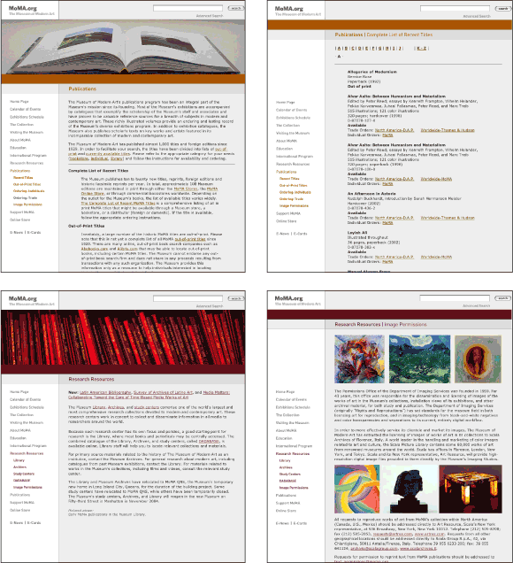
Consistency Cont..
The site applies a consistent design to all its Web pages—navigation links in the left column, the search field in the upper right corner, and the section heading at the top of the page. Design consistency allows users to quickly form a model of the workings of a site and successfully apply it throughout the site

Slide 25
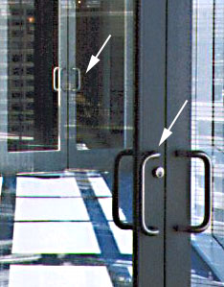
Affordances
This set of doors connects a walkway between two buildings
  Although both sides of both sets of
  doors have handles, only the outer
  handles are meant to be pulled
  Using either set of doors once inside
  the walkway, to exit, one needs to
  push
  Feel trapped??

Slide 26
Affordances Cont..
Referring an attribute of an object that allows people to know how to use it.
Simple words , it that by looking at the object design you have a clue about it. The physical button on a mouse gives a clue that it can be clicked to perform an action. When an object has strong affordances, it's very clear how to use it

Slide 27
Affordances (Physical)
The designer have to provide explicit cues that help user determine what effect(s) their interaction will have, when to carry out specific actions, and to help them establish whether these actions have been successful/unsuccessful.
Affordance is not limited to the design of physical objects, in fact, the concept has been especially appealing to designers of graphical user interfaces.
User interface designers can more freely and easily define visual properties of the objects they create

Slide 28
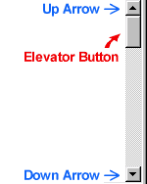


Affordances – Perceived Affordance in User Interface
  Virtual affordances (logical)
    How do the following screen objects afford?
    What if you were a novice user?
    Would you know what to do with them?

Slide 29
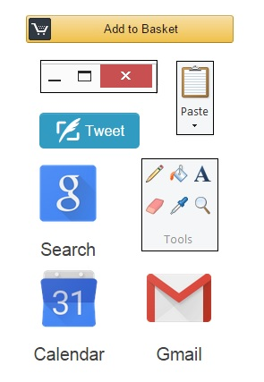
Affordances – Perceived Affordance in User Interface

Slide 30
Affordances – Perceived Affordance in User Interface
Another Examples of user interface elements, which provide this kind of strong clues, are clickable (footnote 2) buttons and hyperlinks (image A) ,clickable tabs(Image C), draggable sliders (Image B), swipable touchscreen (Image D) and spinnable controls(Image E), as well as other elements that more or less directly suggest suitable user actions

Slide 31
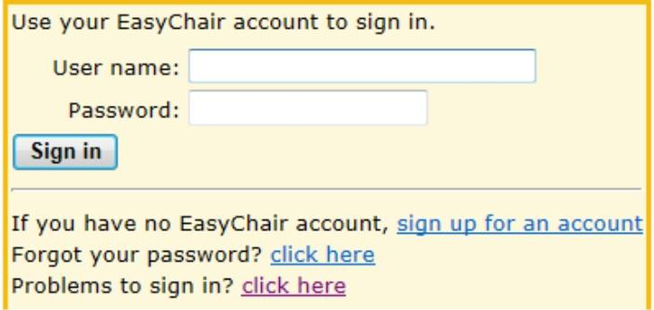
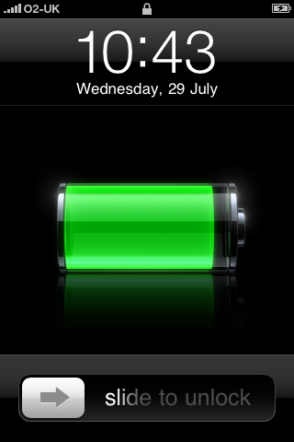
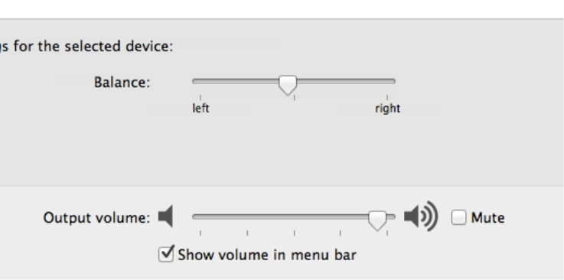
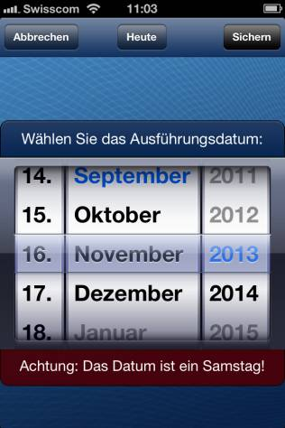

Affordances – Perceived Affordance in User Interface
A-
D -
B -
E
C -

Slide 32
Design Principles revisited
Visibility
  Placing the controls in a highly visible location
Feedback
  provision of information about the result of an action
Constraints
  Restricting the possible actions that can be performed helps prevent user from selecting incorrect options
Mapping
  Mapping is the relationship between controls and their action or effect in the world
Consistency
  Internal consistency refers to designing operations to behave the same within an application
  External consistency refers to designing operations, interfaces, etc., to be the same across applications and devices
Affordances
  properties of an object that indicate how it can be used

Slide 33
Question and Answer Session
Q & A

Slide 34
Next Session
Topic and Structure of next session
Usage Environments
Notes:
Proceed with giving the students the task for their second tutorial (finding badly design product) as they are to present their work in the next tutorial session

